Slide 1


Social Buzz Content Analysis

Slide 2


Today's agenda
Project recap
Problem
The Analytics team
Process
Insights
Summary

Slide 3


Social Buzz a ‘content-centric’ social media platform engaged our services for a 3-month initial project with the following expectations:
An audit of their big data practice
Recommendations for a successful IPO
An analysis of their content categories that highlights the top 5 categories with the largest aggregate popularity.
Project Recap

Slide 4


Problem
Over 100000 post per day.
36,500,000 pieces of content per year!
Analysis to find Social Buzz’s top 5 most popular categories of content.

Slide 5



Chief Technical Architect
Andrew Fleming
The Analytics team
Senior Principle
Marcus Rompton
Data Analyst
Andrew Sobe-Olisa

Slide 6

Process
1
Data Understanding.
2
Data Cleaning.
3
Data Modelling.
4
Data Analysis.
5
Uncover Insights.

Slide 7


Insights
Animals , Science, Healthy-Eating, Technology and Food are the top 5 categories based on popularity scores of 127476, 71168, 69339, 68738, 66676 respectively.
Tennis, Veganism and Public speaking are the bottom 3 categories based on popularity scores of 49264, 49619 and 50339 respectively.
There are 16 unique Categories.
There are sixteen unique reactions In the Most popular category(Animal).
May is the Month with the highest number of posts.

Slide 8
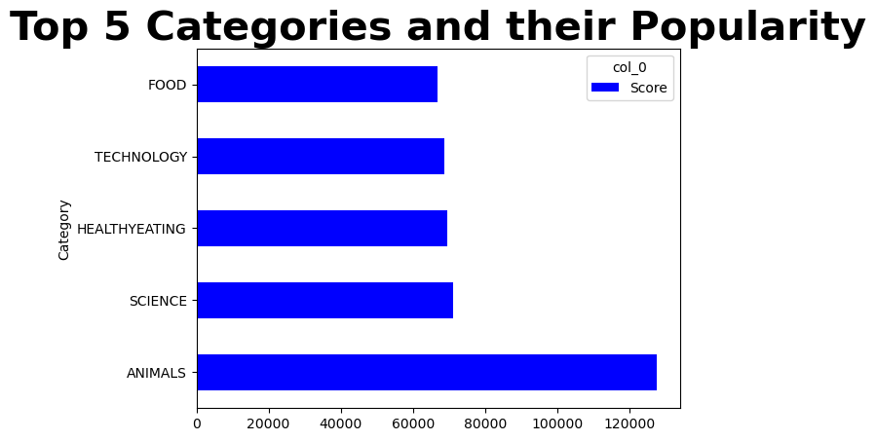
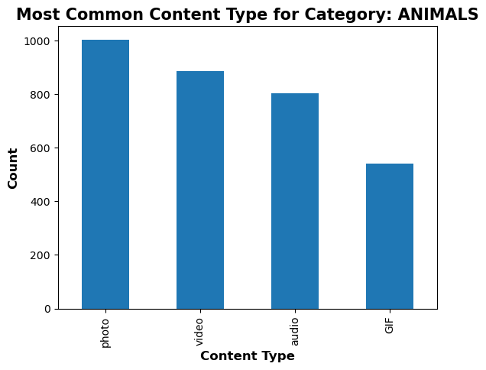
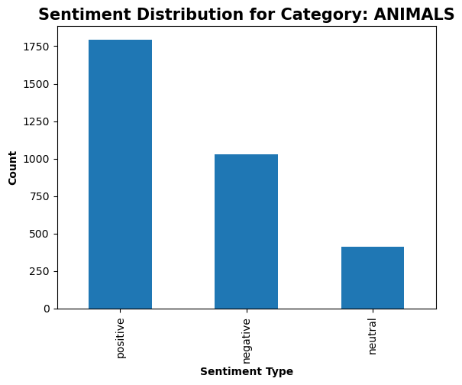
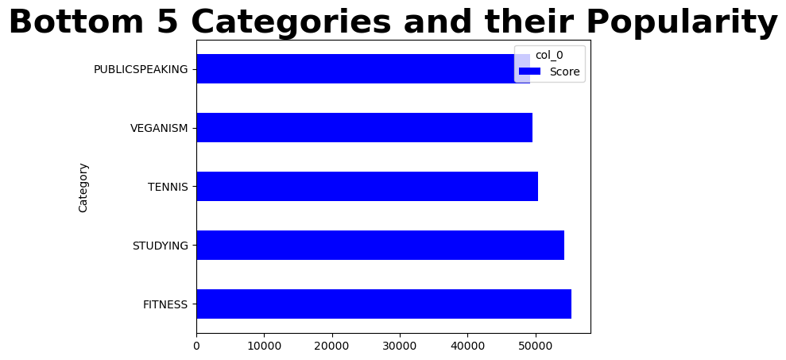
Top Five Categories in the dataset are:
Animals, Science, Healthy-eating, Technology and Food. The Popularity of Animal category increased after adding dogs to this category.

Slide 9
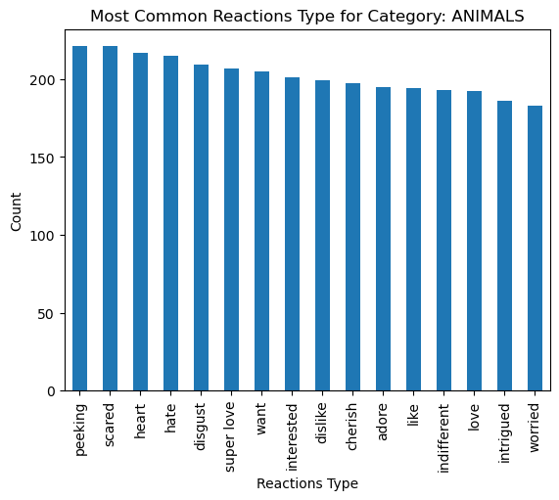
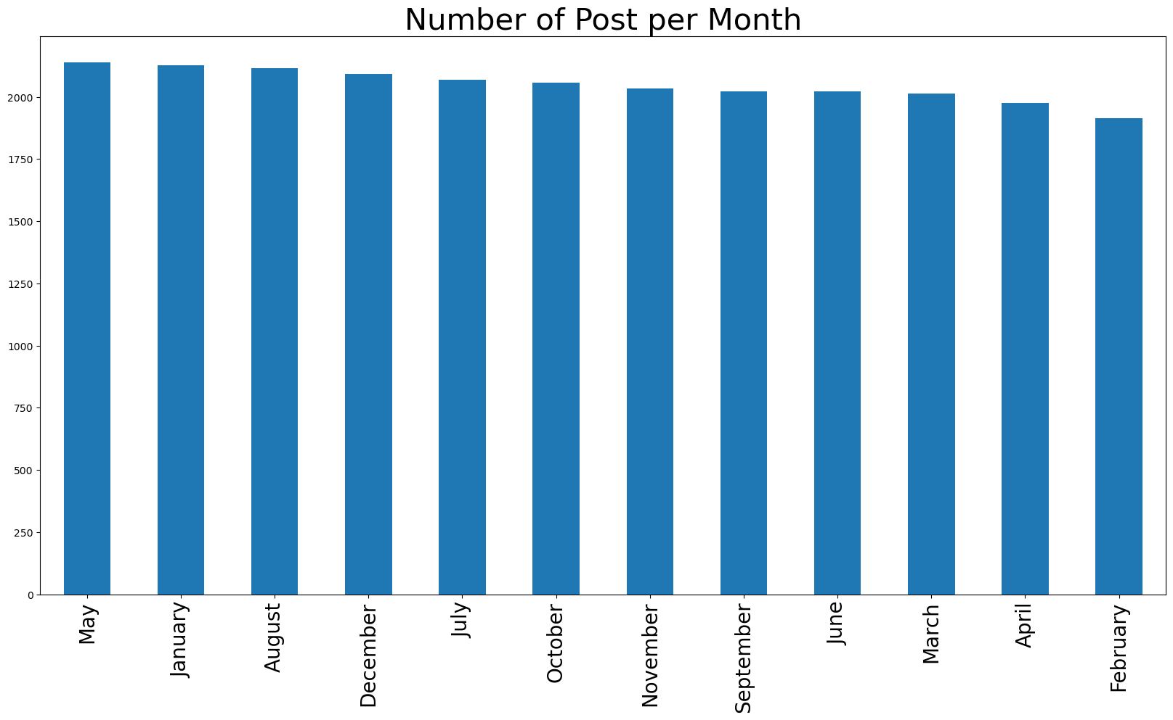
Number of Post by Month shows that May has the Highest number of post with February having the least( maybe cause it has less days?)
Most common reaction Type for Animal Category with ‘Peeking’ being the most common reaction while ‘Worried’ is the least reaction. My guess is that most of the animals are pets.

Slide 10


Dataset has 16 Unique Categories.
Animal is the most popular Category, it's `Sentiment` is largely positive and majority of the content are photos.
Public-speaking is the least.
There are 16 unique reactions in the Animal category with Peeking being the most frequent and worried the least.
May has the highest number of post, while February has the least.
Most of the content made on Social Buzz are Photos followed by video ,GIF and audio respectively.
Summary

Slide 11

Thank you!
ANY QUESTIONS?

